Slide 1

AMPERE
Assessing Pathways toward Ambitious Climate Targets at the Global and European Levels
The AMPERE project is funded by the European Union’s Seventh Framework Programme (FP7/2007-2013)

Slide 2
Acknowledgement
The AMPERE project in funded by the European Union’s Seventh Framework Programme FP7/2010 under grant agreement
n° 265139 (AMPERE).
AMPERE stands for Assessment of Climate Change Mitigation Pathways and Evaluation of the Robustness of Mitigation Cost Estimates

Slide 3

The AMPERE modelling platform
>3 million EUR from the EU 7th Framework Programme
22 partners from the EU, China, India, Japan and the USA
17 energy-economy and integrated assessment models
AMPERE has helped to establish a coordinated European modelling platform

Slide 4





















The AMPERE Consortium
Project Coordinator:
Potsdam Institute for Climate Impact Research (PIK)
Paul Scherrer Institut (PSI)
MetOffice Hadley Centre
International Institute for Applied Systems Analysis (IIASA)
Centre national de la recherche scientifique (CNRS)
Climate Analytics
Enerdata
National Institute for Environmental Studies (NIES)
Utrecht University (UU)
EU-JRC-Institute for Prospective Technology Studies (IPTS)
Fondazione Eni Enrico Mattei (FEEM)
Research Institute of Innovative Technology for the Earth (RITE)
Institute of Communication and Computer Systems (ICCS)
University of Stuttgart
NDRC Energy Research Institute (ERI)
Vienna Technical University, Energy Economics Group (EEG)
Centre for European Policy Studies (CEPS)
Indian Institute of Management (IIM)
CPB Netherlands Bureau for Economic Policy Analysis
Centre International de Recherche sur l’Environnement et le Développement (CIRED)
External partner:
Pacific Northwest National Laboratory’s Joint Global Change Research Institute (JGCRI)
Université Paris I Pantheon-Sorbonne (ERASME)

Slide 5
Key AMPERE findings
Climate goals:
Global progress to reduce greenhouse gas emissions over the next two decades is crucial for achieving ambitious climate targets at low costs
The international context:
Europe can signal the will to strong emission reductions – with large climate benefits if others follow
EU decarbonisation:
Decarbonisation holds challenges and opportunities for Europe

Slide 6
CLIMATE GOALS
Global progress to reduce greenhouse gas emissions over the next two decades is crucial for achieving ambitious climate targets at low costs

Slide 7
Climate goals and carbon budgets:
Closing the gap between current policies and climate stabilisation requires adherence to a tight budget
Reaching 2°C requires adherence to a tight global emissions budget
Cumulative CO₂ emissions need to stay within about 1000 GtCO₂
Requires fundamental and rapid transformations
Current global policies are insufficient to reach the 2°C objective
Global warming is projected to reach 3.2-3.8°C this century
Global GHG emissions

Slide 8
Climate goals and delay:
Delayed action results in the need for unprecedented mitigation in the following decades
Near-term climate action by 2030 will be critical
Continuation along current pledges exhausts ~70% of the emissions budget by 2030
The lack of near-term mitigation needs to be compensated by massive emissions reductions later in time
The findings suggest global GHG emissions targets of less than 50 GtCO₂ by 2030
Implications of delayed action
for reaching 2°C

Slide 9
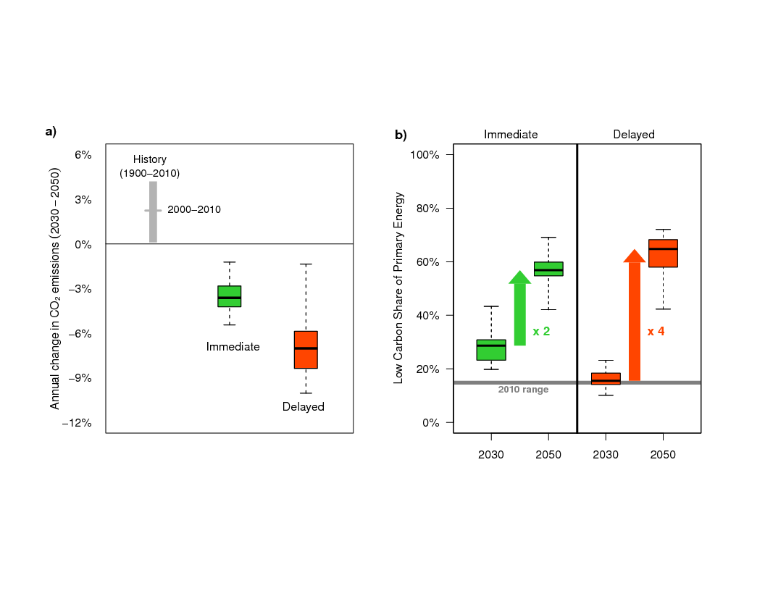
Climate goals and delay:
Delayed action until 2030 requires a more rapid and costly transformation of the global energy system
Consequences of delayed action for achieving 2°C:
Massive acceleration of the energy transformation post 2030
Rapid low-carbon energy technology diffusion
Exuberated technical, economic, social and political challenges
Emissions Reduction
Upscaling of Low-Carbon Energy

Slide 10
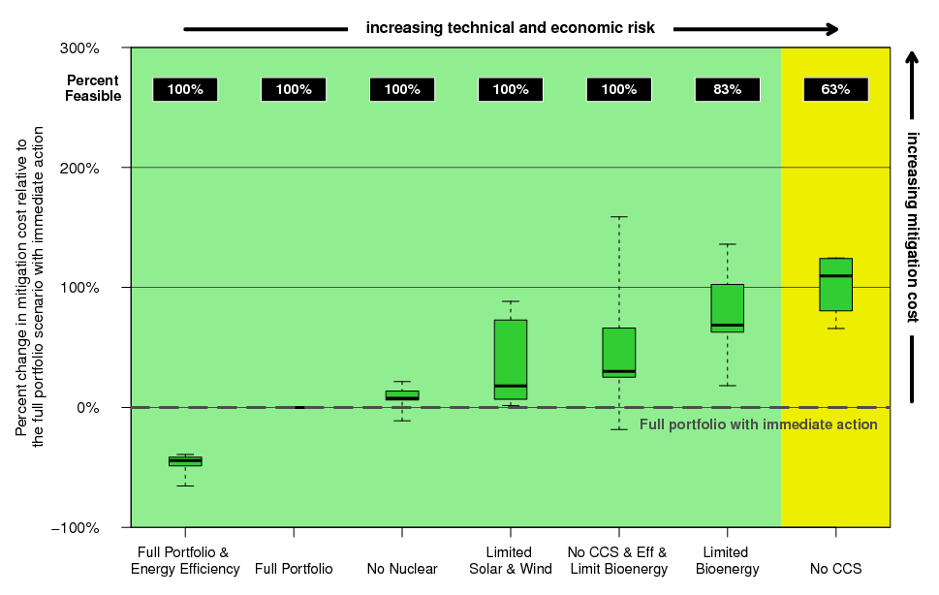
Climate goals and mitigation options:
Delayed action until 2030 increases reliance on specific mitigation options
Mitigation costs of immediate action

Slide 11
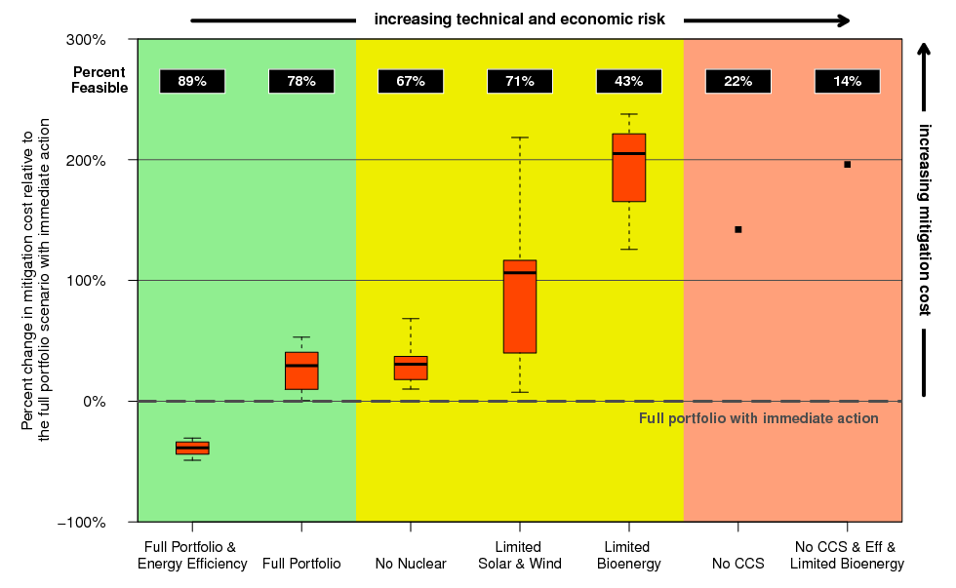
Climate goals and mitigation options:
Delayed action until 2030 increases reliance on specific mitigation options
Mitigation costs of delayed action
Efficiency!!
Low risk & low cost

Slide 12
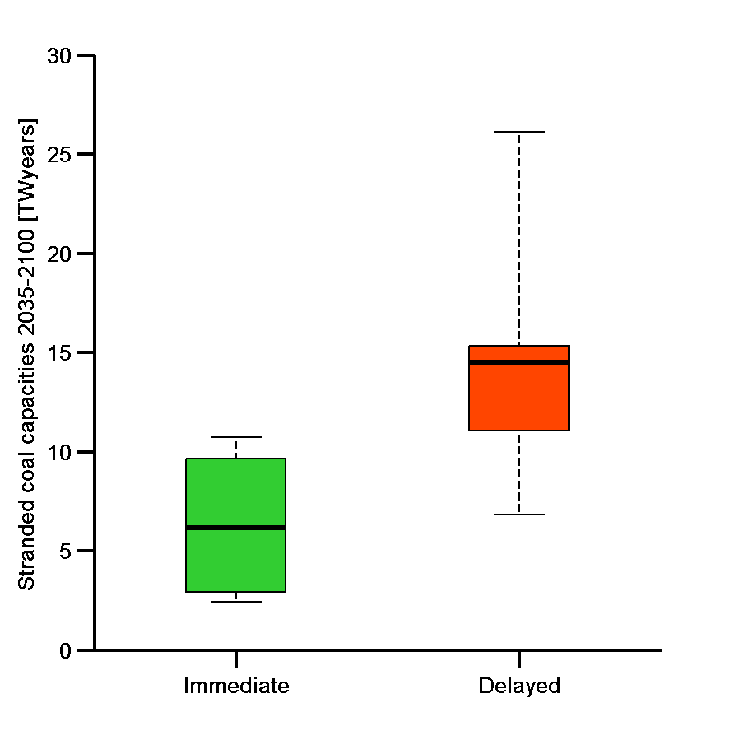
Climate goals and carbon lock-in:
New investments in coal-fired power plants without CCS should be avoided, if ambitious climate goals are to be achieved
Lock-in of fossil-intensive infrastructure would require premature shutdown after 2030
  Stranded assets in the order of hundreds of GW of coal power plants
Stranded assets (coal power plants)
* Global electricity generation in 2010 = 2.5 TWyears

Slide 13
THE INTERNATIONAL CONTEXT
Europe can signal the will to strong emission reductions – with large climate benefits if others follow

Slide 14
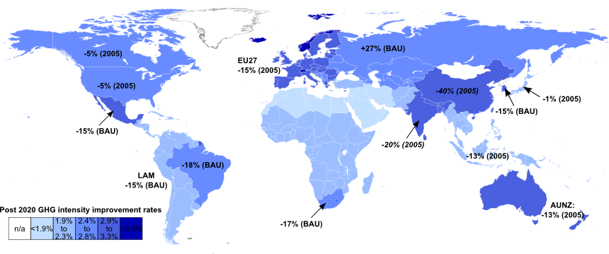
Climate policies in the international context:
International climate policy remains uncertain despite some movement by major emitters
Diverse national policies; mixed progress on Copenhagen pledges for 2020
AMPERE reference policy scenario:
Regional 2020 emission targets (China & India: GHG intensity targets)
            Regional renewable and nuclear energy targets for 2020 or 2030
            Extrapolation of GHG intensity improvements beyond 2020

Slide 15
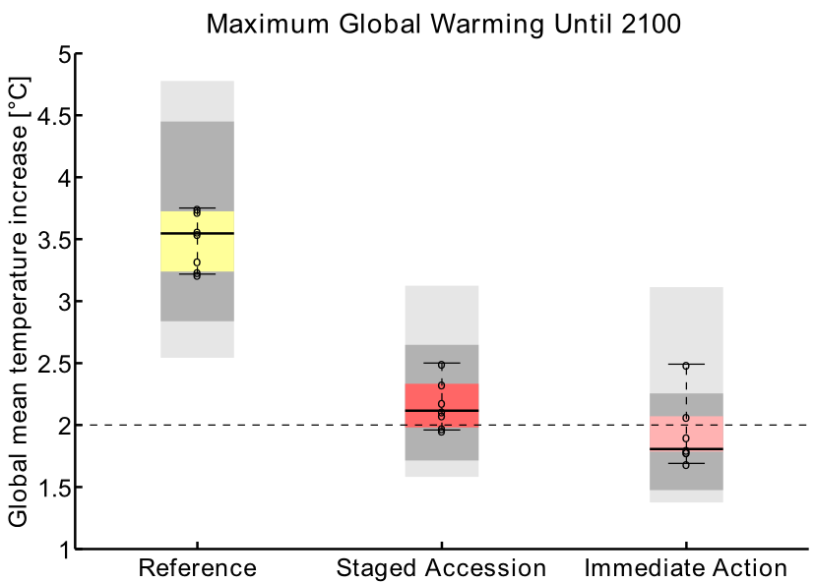
Limiting global warming in the international context:
A strong climate policy signal by the European Union reciprocated by other major emitters can effectively limit global warming
A continuation of current policies does not halt warming
EU alone has little effect on this
Warming can be reduced significantly
  if all major emitters join stringent action by 2030 (staged accession)
The 2ºC target is likely surpassed temporarily
in a staged accession setting
(by 0.5ºC or less)

Slide 16
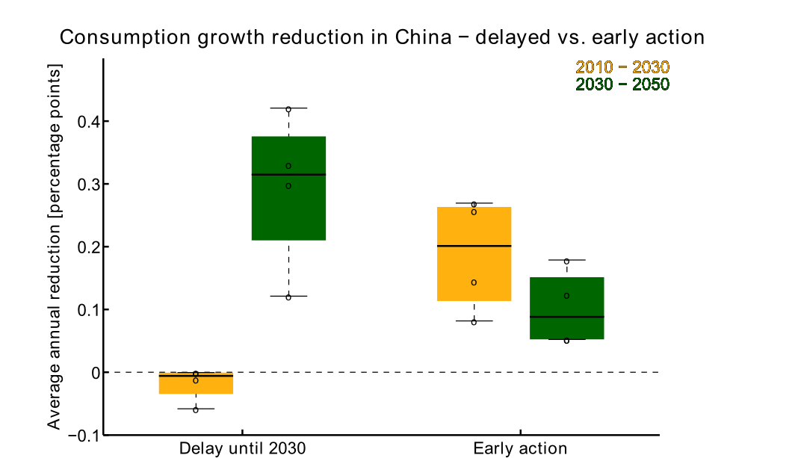
Transitional challenges in the international context:
Countries face a trade-off between early costs and later transitional challenges
Early movers have higher near term mitigation costs
Late movers face higher transitional impacts from delayed action
Co-benefits of early action can be significant
(e.g. air quality)

Slide 17
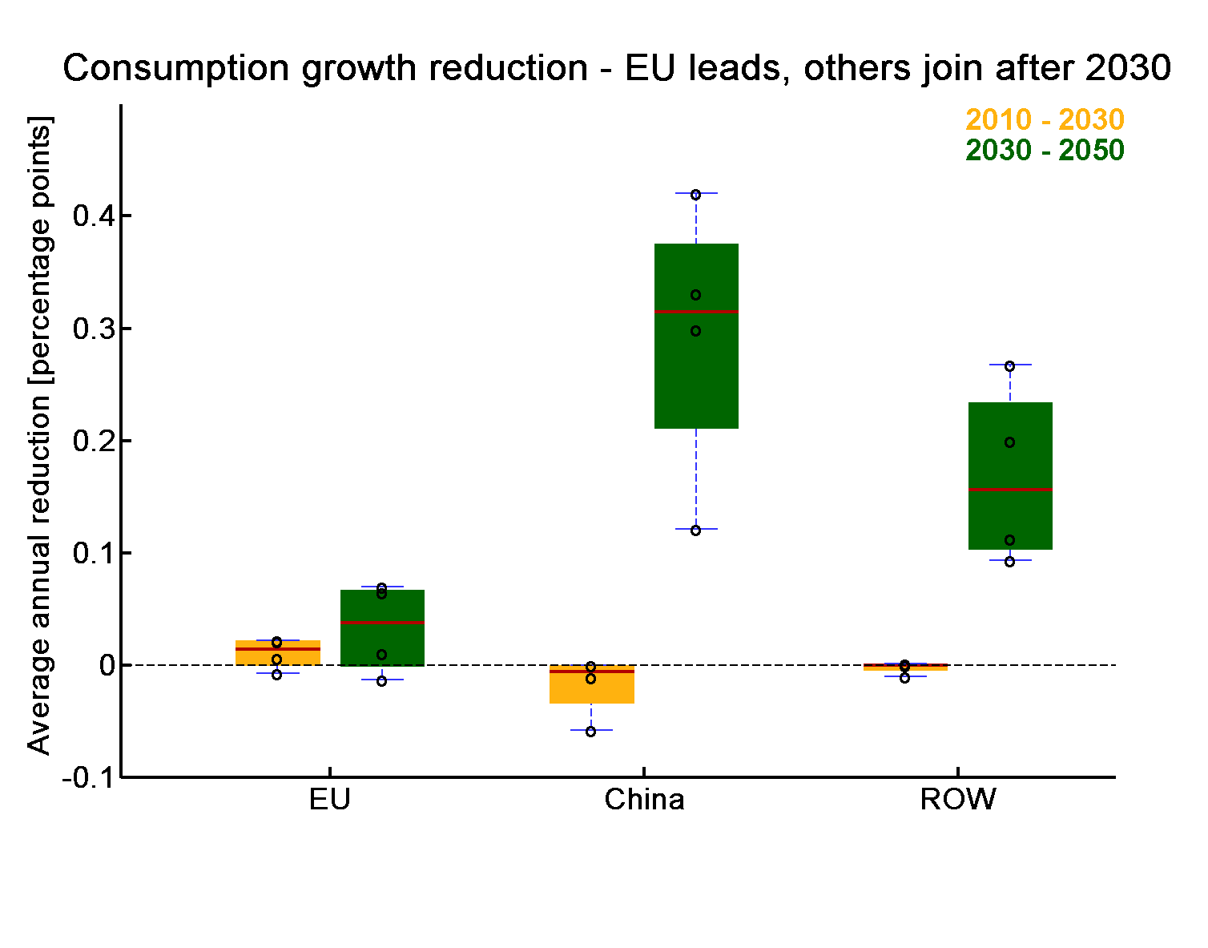
Europe’s economic cost in the international context:
Europe can send a strong climate policy signal at manageable economic cost
EU Roadmap
emission reductions consistent with EU action in 2ºC scenarios
(-40/-80% in 2030/50)
moderately stronger than reference policy
(-30/-40% in 2030/50)
Only moderate costs of adopting the roadmap
(cumulative costs thru 2030
0 to 0.8 percentage points higher than in reference case)

Slide 18
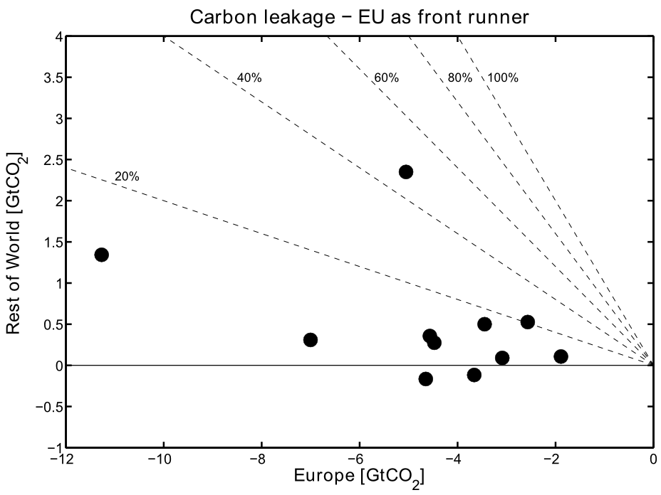
Carbon leakage in the international context:
Overall carbon leakage from unilateral European climate action is expected to be small
Carbon leakage rate 20% or smaller
Leakage in energy intensive industries (GEM-E3 results):
max. 30% leakage rate
max. 1.5% output reduction in any sector

Slide 19
EU DECARBONISATION
Decarbonisation holds challenges and opportunities for Europe

Slide 20
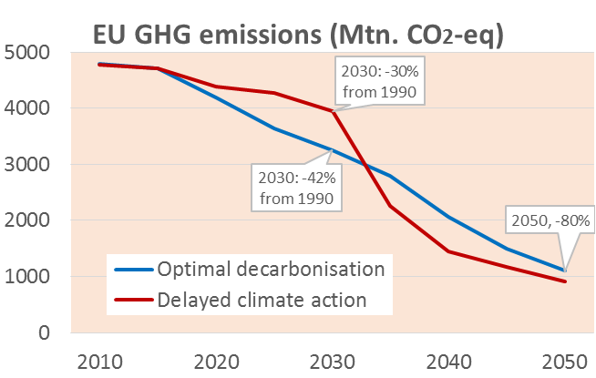
EU decarbonisation and 2030 targets:
The European Union’s decarbonisation requires strong
2030 targets
Delayed climate action until 2030 increases costs of decarbonisation:
Higher abatement efforts after 2030
Lock-ins in the energy sector and lack of infrastructure
Delays in learning progress for renewable energy, CCS, batteries, etc.
The AMPERE findings suggest a 40% GHG reduction in EU emissions by 2030 as a cost-effective milestone for 80% reduction by 2050

Slide 21
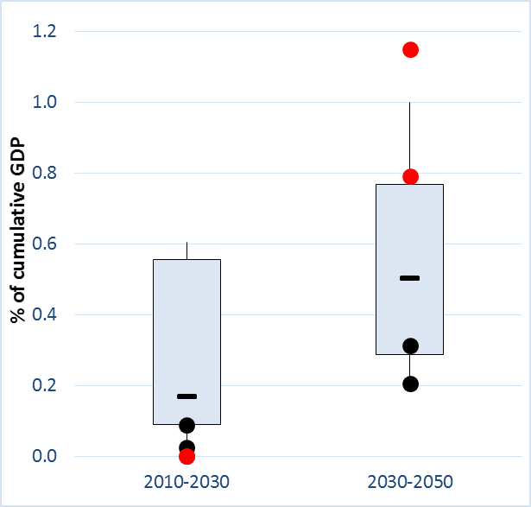
EU decarbonisation and 2030 targets:
The European Union’s decarbonisation requires strong
2030 targets
40% reductions by 2030 can be achieved at moderate costs if the full range of mitigation options is available
Delaying strong climate action until 2030:
  implies a very steep reduction pathway after 2030
  stresses the system capabilities for decarbonisation
EU decarbonisation costs compared to Reference (as % of GDP)
Black dots = costs for optimal decarbonisation
Red dots = costs for delayed action until 2030

Slide 22
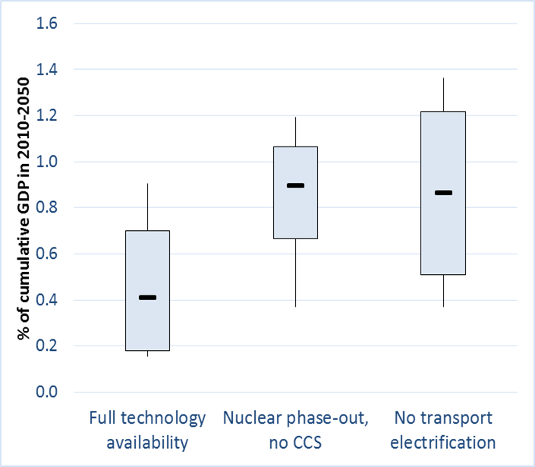
Key factors of EU decarbonisation:
Carbon-free electricity, energy efficiency and transportation electrification are critical for decarbonisation of the EU energy system
Energy efficiency is critical
Non-availability of nuclear and CCS increases mitigation costs
  Need for storage, grids and power system balancing due to massive penetration of intermittent renewables
Delays in transport electrification increase mitigation costs
  Higher CO₂ reductions in other sectors
  Massive deployment of biofuels stressing biomass supply
EU decarbonisation costs compared to Reference
(as % of GDP 2010-2050)
Box plots show range and distribution of model results, black lines indicate median

Slide 23
Sectoral impacts of EU decarbonisation:
Climate policies create opportunities for some European sectors and challenges for others
Higher energy costs due to climate policies tend to increase production costs, reduce demand and imply lower growth of overall economic activity
The reduction is more pronounced in sectors that are directly affected by higher energy costs, such as energy-intensive industries
Decarbonisation increases output and employment in energy efficiency services, equipment goods and in the agricultural sector due to higher demand for bioenergy
Employment impacts can be positive if carbon revenues are redistributed to reduce labour costs
  Domestically produced goods and services for energy efficiency, electric mobility and renewable energy replace imported fossil fuels

Slide 24
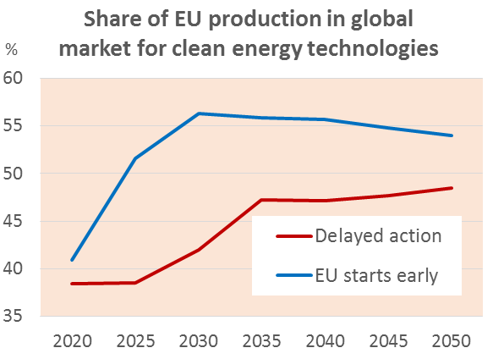
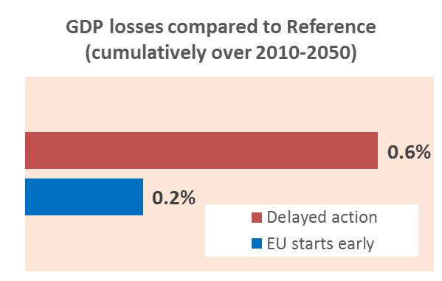
EU decarbonisation and first mover advantage:
If other world regions start decarbonising later, Europe would gain a technological first mover advantage
Europe is sufficiently large to allow for achieving a large part of the learning potential
Assuming that other regions join the climate effort by 2030, Europe can get economic benefits from earlier and unilateral climate action:
  Competitive advantage and increase in exports of clean energy technologies
  Electric vehicles, CCS and RES are among the winners in EU exports
  Lower compliance costs because of prolonged period of restructuring

Slide 25
Thank You

